Slide 1
finding an optimal location of opening an outdoor activities center
Capstone Project - The Battle of the Neighborhoods

Slide 2
Introduction: Business Problem
Recently, there has been a steadily increasing trend that HongKongers love doing outdoor activities.
In this project, we will find an optimal location of opening an outdoor activities center, by filtering out nature neighborhoods amoung 18 districts in Hong Kong.
Because the more nature elements in neighborhoods will make outdoor activities more accessible and attractive.

Slide 3
Data
Official District Councils website (https://www.districtcouncils.gov.hk/index.html) contains all the areas located in 18 districts in Hong Kong, with the following columns:
Area
Districts
Using Open Street Map (OSM) - Nominatim to retrieve a specific location's latitude & longitude, with the following columns:
Districts (neighborhood)
latitude
longitude
Using FourSquare to retrieve a specific location's nearby venues, with the following columns:
Neighborhood
Venue's latitude
Venue's longitude
Venue's category

Slide 4
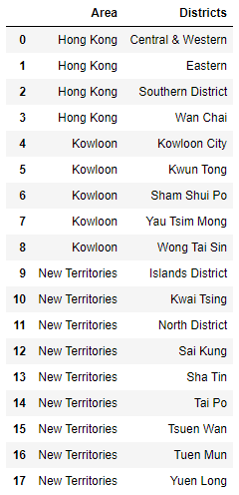
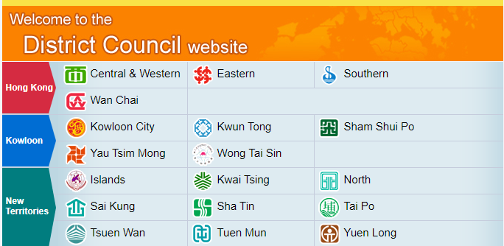
Methodology
Retrieve data from website

Slide 5
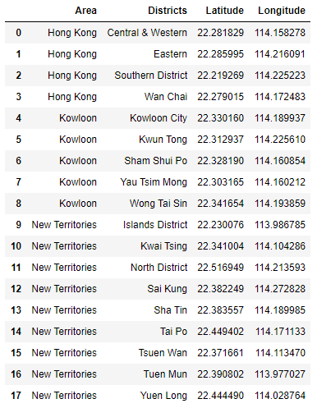
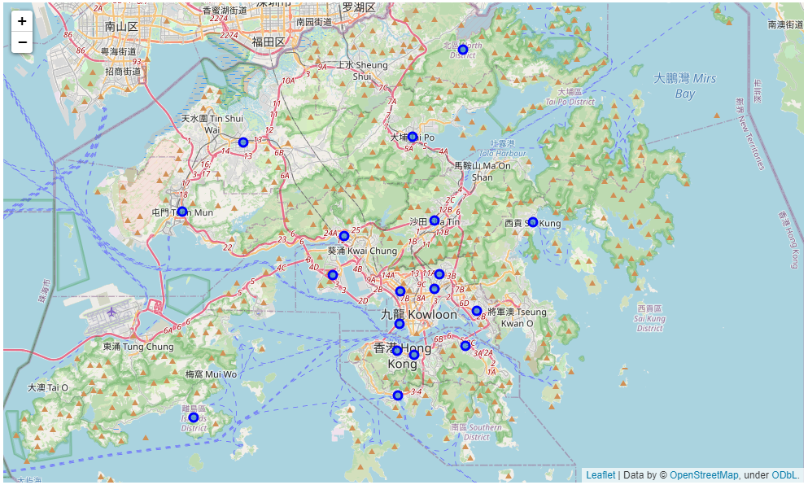
Methodology(CONT.)
Retrieve data from OSM

Slide 6
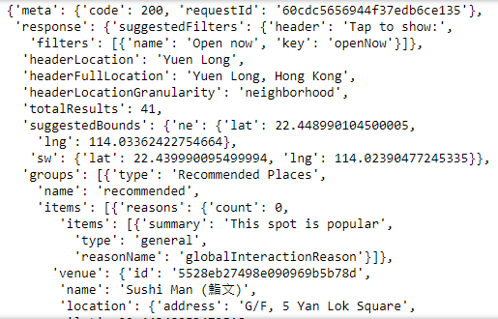
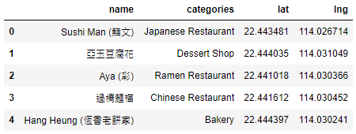
Methodology(CONT.)
Retrieve data from FourSquare

Slide 7

METHODOLOGY(CONT.)
Handle with incorrect latitude & longitude data

Slide 8
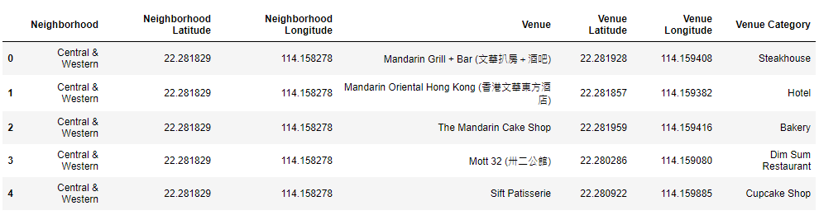
METHODOLOGY(CONT.)
Join different sources of data together, by using common joining key - Districts (neighborhood)

Slide 9
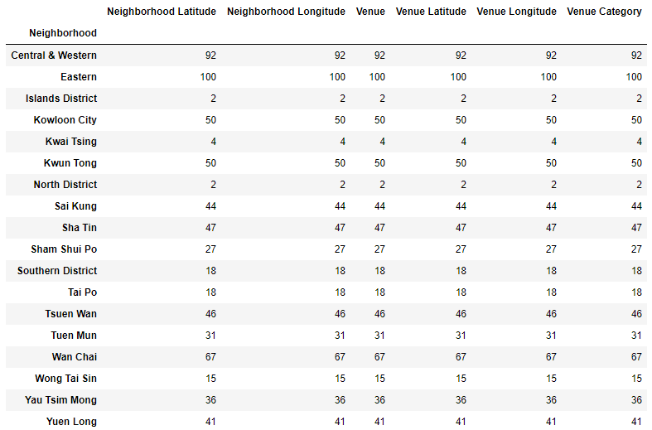
METHODOLOGY(CONT.)
Count number of Venue Group by Neighborhood

Slide 10
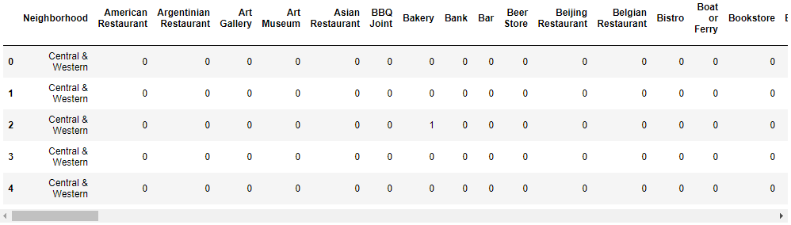
METHODOLOGY(CONT.)
Analyze each neighborhood in Hong Kong by One-hot

Slide 11
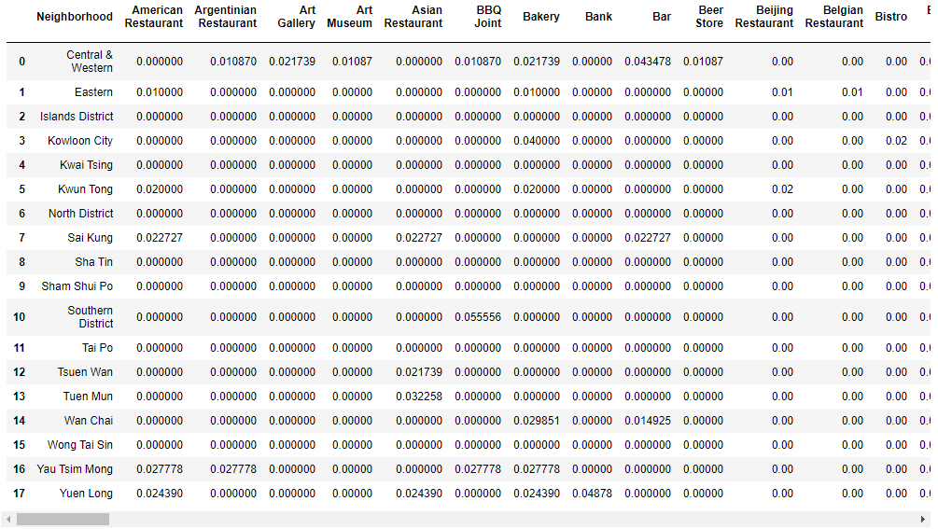
METHODOLOGY(CONT.)
Calculate mean of existence per Venue by Neighborhood

Slide 12
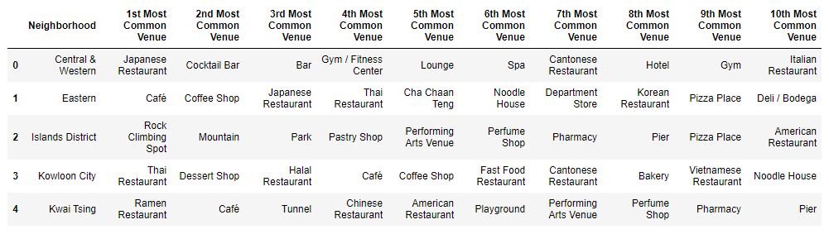
METHODOLOGY(CONT.)
Count for each venue's frequency and sort for the top 10 most common venues in each neighborhood

Slide 13
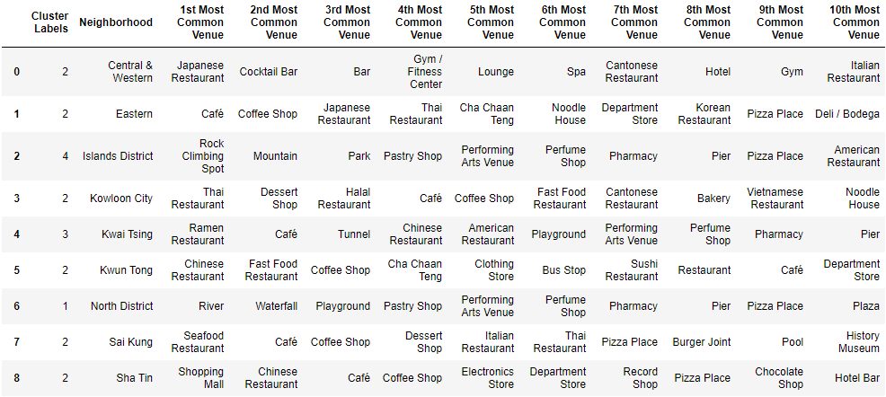
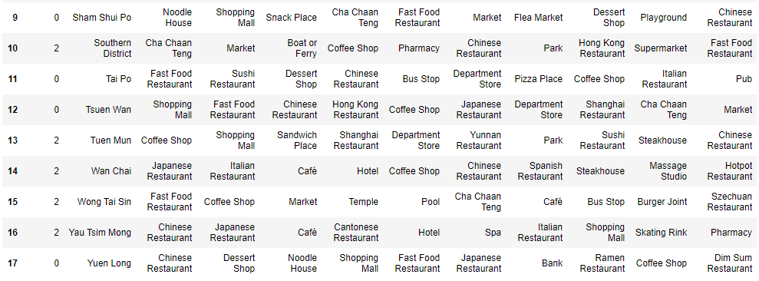
METHODOLOGY(CONT.)
Clustering each neighborhood by 5 clusters

Slide 14
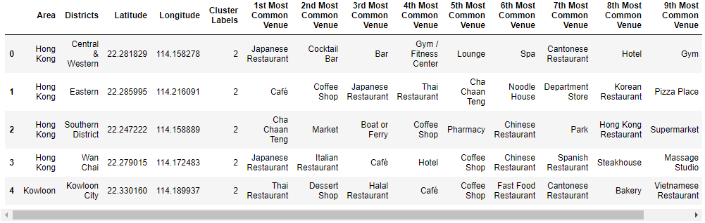
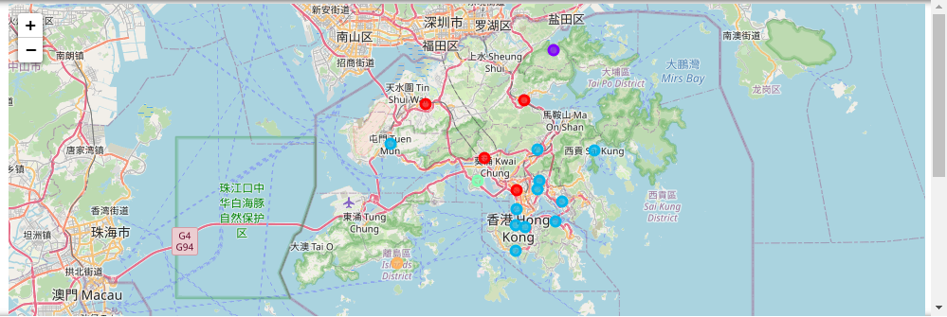
METHODOLOGY(CONT.)
Join the top 10 most common venues in each neighborhood to Area and Districts with Latitude and Longitude

Slide 15
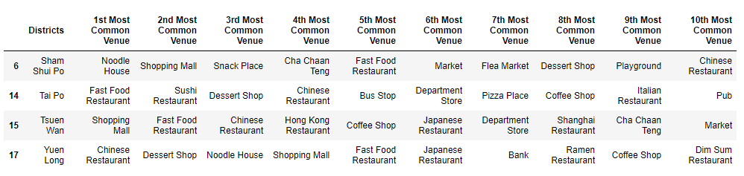
METHODOLOGY(CONT.)
Examine Clusters
Cluster 0

Slide 16
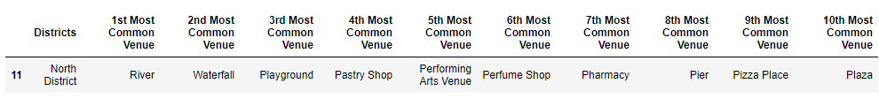
METHODOLOGY(CONT.)
Examine Clusters
Cluster 1

Slide 17
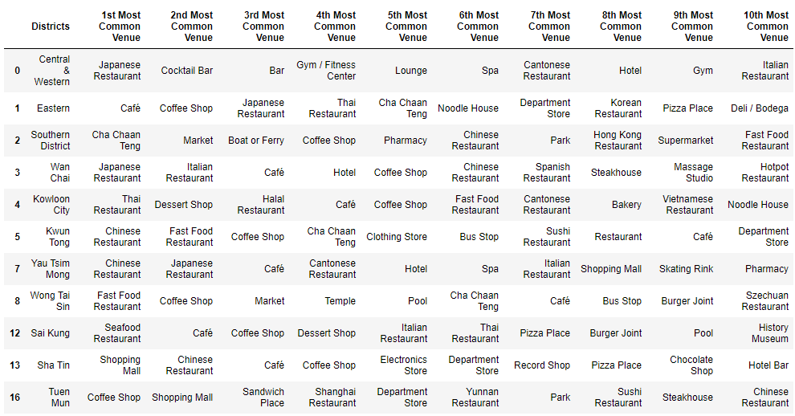
METHODOLOGY(CONT.)
Examine Clusters
Cluster 2

Slide 18
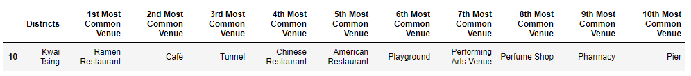
METHODOLOGY(CONT.)
Examine Clusters
Cluster 3

Slide 19
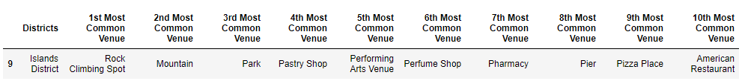
METHODOLOGY(CONT.)
Examine Clusters
Cluster 4

Slide 20
Analysis
Cluster 0
All of them are many people living inside
The most common venues are restaurants for residents' daily needs
There are no nature elements
It is not suitable for opening an outdoor activities center
Cluster 1
The first three common venues are River, Waterfall and Playground
It is suitable for opening an outdoor activities center especially for water activities.

Slide 21
ANALYSIS(CONT.)
Cluster 2
All of them are flourishing and crowded places
There are many different kinds of venues, including restaurants, coffee shop, bar, gym and spa
There are diverse activities to do, outdoor activities may not be considered
Cluster 3
The 3rd most common venue is Tunnel, which indicate it is an important transportation hub and no suitable environment for outdoor activities

Slide 22
ANALYSIS(CONT.)
Cluster 4
The first three common venues are Rock Climbing Spot, Mountain, Park
It is suitable for opening an outdoor activities center especially for hiking and outing.

Slide 23
Results
Our analysis shows that Cluster 1 and Cluster 4 are both suitable for opening an outdoor activities center as there are a lot of nature elements inside, such as River, Waterfall, Rock Climbing Spot and Mountain
Cluster 1 is suitable for water activities while Cluster 4 is suitable for hiking and outing

Slide 24
Discussion
We should decide the which outdoor activities are more attractive to target customers
We may find the number of people joining water activities and hiking/outing per year to determine which of them are more popular and the trend of the activities in the future
Economic considerations, for example the rent of Cluster 1 and 4
We may find the rent data from real estate agent website in recent years

Slide 25
Conclusion
Cluster 1 and cluster 4 were found as suitable for opening an outdoor activities center as there are lots of nature elements
Final decission on optimal outdoor activities center location will be made by stakeholders based on specific characteristics of neighborhoods and locations in every recommended zone
Taking into consideration additional factors like attractiveness of each location, real estate availability, prices, social and economic dynamics of every neighborhood etc.

